Slide 1


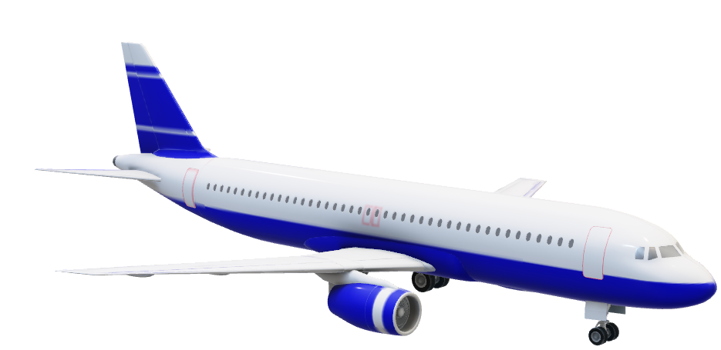
FlySmart
Application
By Валери Бънев
© 2023 Amadeus IT Group and its affiliates and subsidiaries

Slide 2
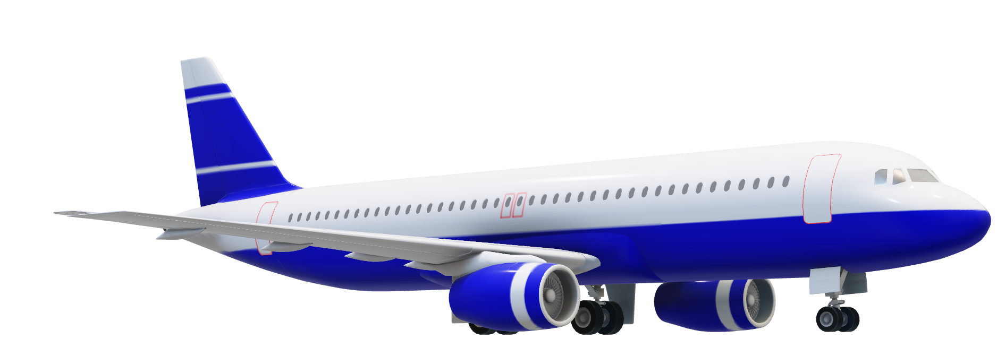
Please feel free to ask questions
at any point of the presentation
during the flight.
© 2023 Amadeus IT Group and its affiliates and subsidiaries

Slide 3
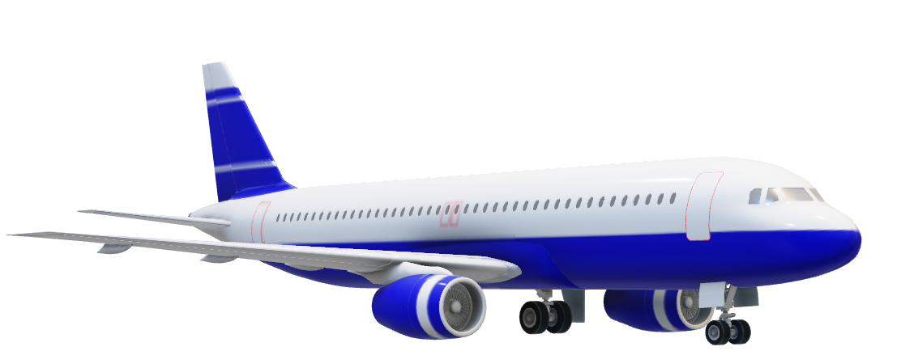
Content:
Project structure
Rest API fast preview
Application architecture
Postman demo
© 2023 Amadeus IT Group and its affiliates and subsidiaries

Slide 4
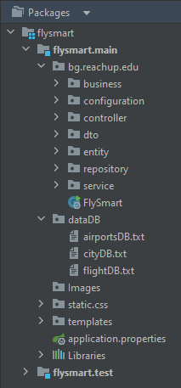
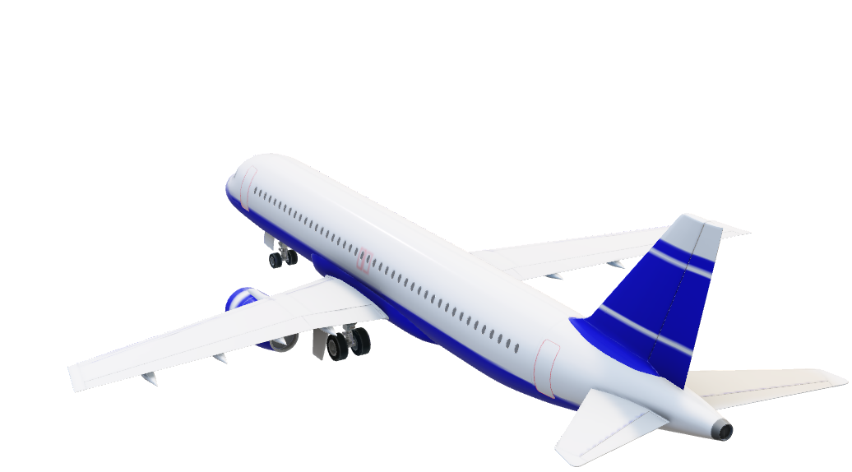
Okay, Let`s start our
app and take a plane!
Project structure
Algorithm and logic.
Custom Exception Handler service.
Migration Service for updating database at building the project.
All controllers for the objects.
DTO objects.
Entity objects in database.
Repo for the APP.
Contains service methods and converting entity from DB to mirror object for transfer.
© 2023 Amadeus IT Group and its affiliates and subsidiaries

Slide 5
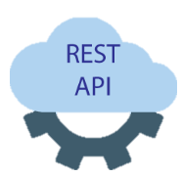
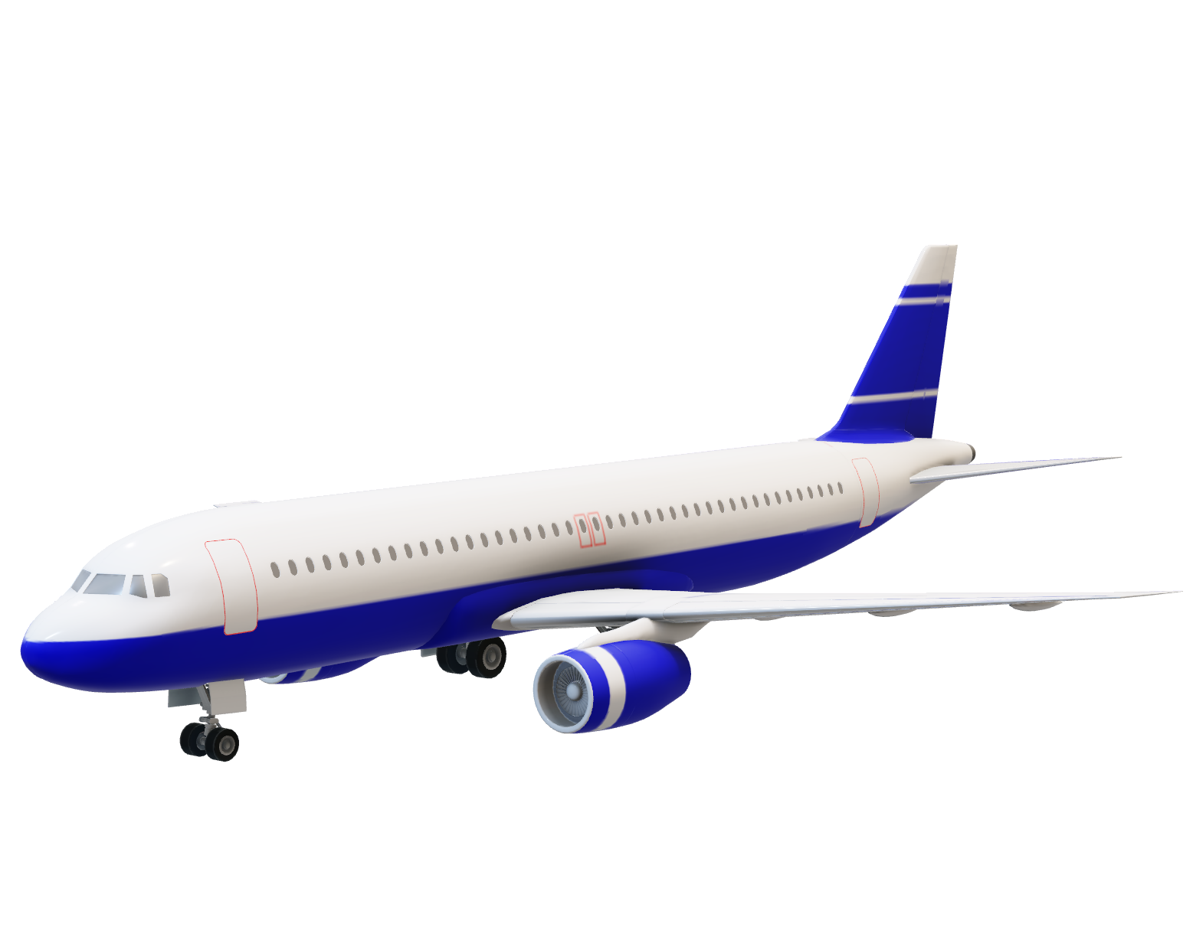
In this application are included standard RESTful API interface.
Uses the http request and response for communication between the client and server.

Slide 6



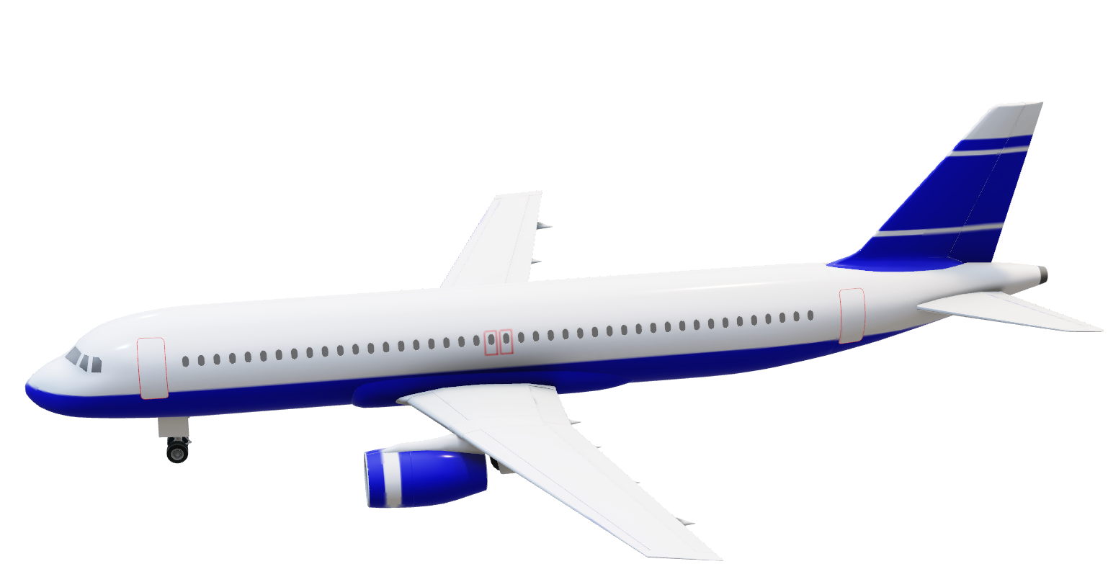
Controller
zone
Services
zone
Repository
zone
RequestMaping
NewEntiry
Find NewEntity in DB
HTTP Master
© 2023 Amadeus IT Group and its affiliates and subsidiaries
App uses Hybernate JPA
to communicate with the
database.
RequestBody JSON
Mirror entity
element from DB
ObjectDTO

Slide 7

Architecture
The application is implemented in Spring MVC and uses standard Service Oriented Architecture
It’s packed as a “.jar” deployable and served by a Tomcat container.
The application conforms to a Layered architecture. Higher layers can only import logic from the lower layers.
* Communication layer
* Business service layer
* Data service layer
The application uses Hybernate JPA to communicate with the database.
© 2023 Amadeus IT Group and its affiliates and subsidiaries

Slide 8
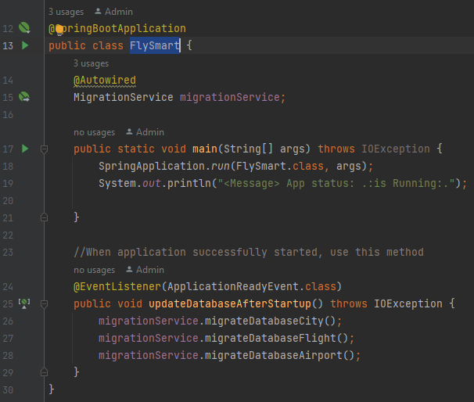
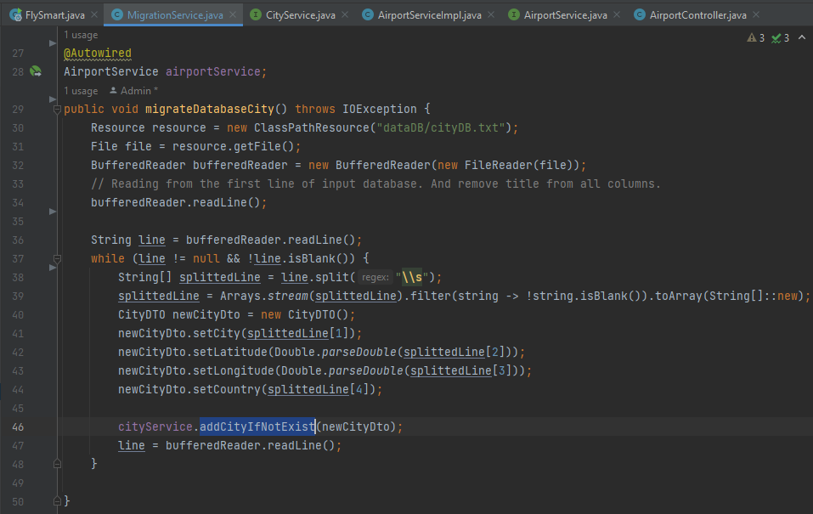

Reusing code example:

Slide 9
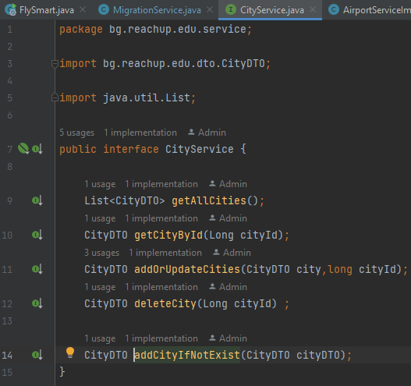
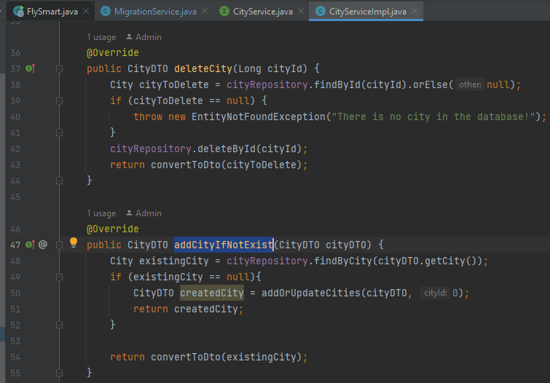
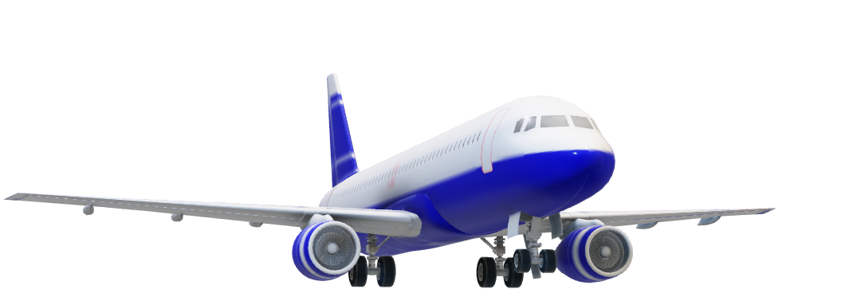
Reusing code example:

Slide 10
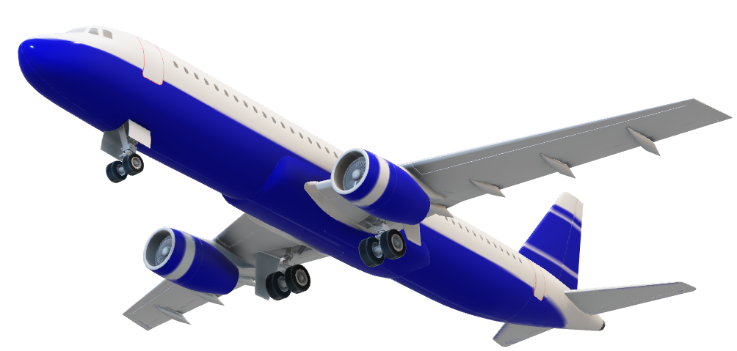
© 2023 Amadeus IT Group and its affiliates and subsidiaries

Slide 11
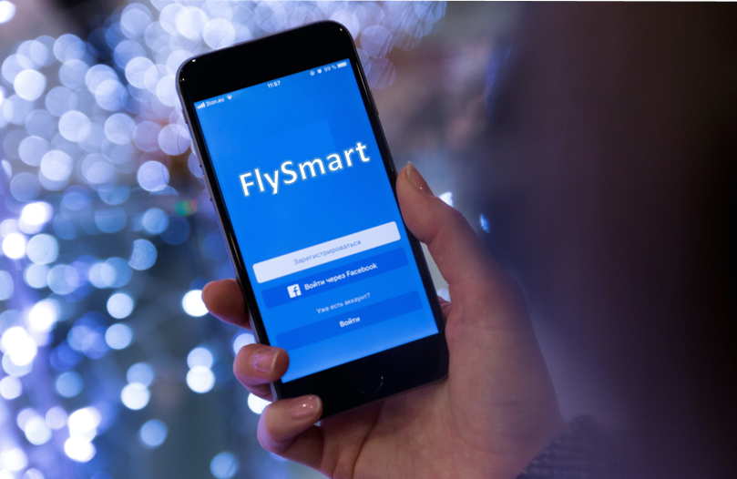
Algorithm Logic
<describe how the algorithm is implemented – min/max, alpha beta, A*, etc>

Slide 12
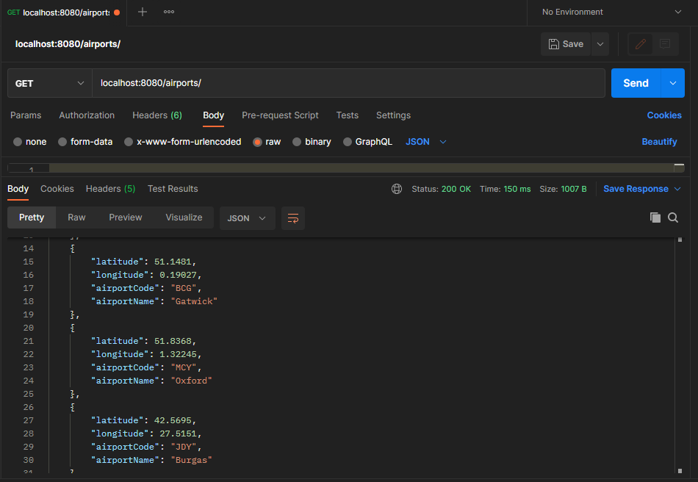


Wets make some sample example in Postman
CRUD
GET
POST
PUT
© 2023 Amadeus IT Group and its affiliates and subsidiaries
DELETE
Communication for complex entities
is done via JSON objects.

Slide 13


Thank you
for your attention!
© 2023 Amadeus IT Group and its affiliates and subsidiaries

Slide 14



Any questions?
Contacts:
Valeri Banev
+359886 11 44 72
valeri_bv@abv.bg
https://gitlab.edu.reachup
.bg/valeri_bv
© 2023 Amadeus IT Group and its affiliates and subsidiaries

